Slide 1

GoodCab’s
Case Study
Driving Growth and Passenger Satisfaction : Performance Insights for GoodCabs' Tier-2 Cities across India.
A research Project By ARGHADIP

Slide 2

About
GoodCab’s
A cab service company operating in tier-2 cities across India
Established two years ago, rapidly growing in the transportation sector
Supports local drivers for economic sustainability
Focused on passenger satisfaction and service efficiency

Slide 3

Agendas
Project Goals
Objective
Important Factors to Optimize Business
Key Findings
Dataset Overview
Data Analysis
Recommendations

Slide 4

Project Goals
Identify growth opportunities and bottlenecks
Improve customer experience
Optimize trip distribution and resource allocation
Analyze the key matrices for Tourism focused cities and business focused cities.

Slide 5
Objective
The objective of this project is to analyze key performance metrics of Goodcabs to provide data-driven insights for the Chief of Operations. By evaluating trip volume trends, passenger satisfaction, repeat customer behavior, and trip distribution, this study aims to identify growth opportunities, improve operational efficiency, and enhance customer retention. The findings will help in making strategic decisions to optimize service quality, fleet management, and passenger experience, ultimately contributing to Goodcabs’ long-term success in tier-2 cities.

Slide 6

Important Factors to Optimize Business
Top Performing Cities by Trip Volume & Revenue.
Average Fare per Trip.
Passenger and Driver Ratings.
Peak and Low Demand Months for Each City.
Weekend vs. Weekday Trip Demand.
Repeat Passenger Frequency and City Contribution.
Monthly Target Achievement Analysis.
Repeat Passenger Rate (RPR%) Analysis.

Slide 7
Key Findings
Jaipur performs best over all cities, highlighting its strong tourism appeal. Business based cities like Surat and Indore have high trip volumes but generate lower revenue, indicating frequent but lower-spending business travel.
Tourism based cities have higher fare efficiency per km compared to business cities like Surat and Vadodara. Also Tourism cities have higher travelling distance.
Best-rated cities (Visakhapatnam, Mysore, Kochi, Jaipur) are mostly tourism-focused, suggesting better service satisfaction and Lowest-rated cities (Surat, Vadodara) are business hubs, indicating a need for service improvement.
February is the peak demanded month while June is the low demanded month.
Weekend demand is higher in tourism cities. Business cities see more weekday trips.
Tourism cities have a higher frequency of low-trip repeat passengers (2-4 trips per person), indicating short-term stays. Business hubs have a higher number of repeat passengers making frequent trips.
Most cities underperformed by monthly target. Surat, Lucknow, and Vadodara missing targets by over -60%. Jaipur performed better than others but struggled in March (-28.79%). Mysore was the only city exceeding trip targets in January-March.
Surat, Vadodara, and Lucknow consistently had the worst ratings (-9% to -14% below targets). Jaipur and Mysore had the most stable ratings, often exceeding targets.
Surat (43%) and Lucknow (37%) have the highest Repeat Percentage Rate (RPR %), suggesting strong loyalty. May (33%) have the highest RPR while January (11%) have the lowest.

Slide 8
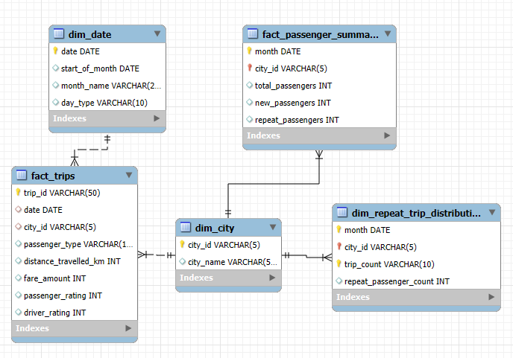
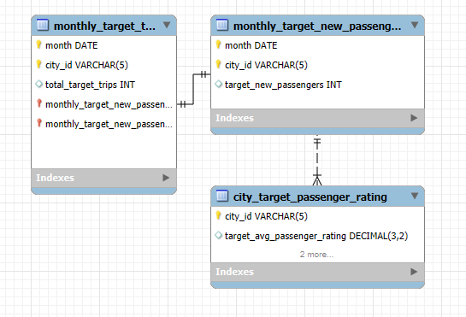
Dataset Overview
The Dataset has the data of 2024 from January to June and the dataset has two database trips_db & targets_db.
📌 trips_db (Operational & Analytical Data)
📌 targets_db (Performance Benchmarks)

Slide 9
Data Analysis

Slide 10
Top Performing Cities by Total trip volume & Revenue
Jaipur dominates in both revenue and trip volume, highlighting its strong tourism appeal. Lucknow and Kochi also attract significant trips, but Kochi sees higher spending per visitor. Business cities like Surat and Indore have high trip volumes but generate lower revenue, indicating frequent but lower-spending business travel.

Slide 11
Average Fare per Trip
City Name | avg. fare / trip | avg. distance travelled | avg. fare / km
Jaipur | 483.92 | 30.02 | 16.12
Mysore | 249.71 | 16.5 | 15.14
Kochi | 335.25 | 24.07 | 13.93
Visakhapatnam | 282.67 | 22.55 | 12.53
Chandigarh | 283.69 | 23.52 | 12.06
Lucknow | 147.18 | 12.51 | 11.76
Coimbatore | 166.98 | 14.98 | 11.15
Indore | 179.84 | 16.5 | 10.9
Surat | 117.27 | 11 | 10.66
Vadodara | 118.57 | 11.52 | 10.29
Jaipur (₹483.92) has the highest fare per trip, while Vadodara (₹118.57) has the lowest.
Tourism cities have higher fare efficiency per km compared to business cities like Surat and Vadodara. Also Tourism cities have higher travelling distance.

Slide 12
Average Ratings by City and Passenger Type
City name | New passenger avg. rating | Repeated passenger avg. rating | avg. driver rating
Visakhapatnam | 9 | 8 | 9
Chandigarh | 8.5 | 7.5 | 7.7
Surat | 8 | 6 | 6.6
Vadodara | 8 | 6 | 6.6
Mysore | 9 | 8 | 9
Kochi | 9 | 8 | 9
Indore | 8.5 | 7.5 | 7.7
Jaipur | 9 | 8 | 9
Coimbatore | 8.5 | 7.5 | 7.7
Lucknow | 8 | 6 | 6.6
Best-rated cities (Visakhapatnam, Mysore, Kochi, Jaipur) are mostly tourism-focused, suggesting better service satisfaction.
Lowest-rated cities (Surat, Vadodara) are business hubs, indicating a need for service improvement.

Slide 13
Peak and Low Demand Months for Each City
Tourism cities peak in May-June due to vacations also in February.
Business cities peak in February-April aligning with corporate travel needs.

Slide 14
Overall Trend of Demand
February has the most demand month and June has low demand.

Slide 15
Weekend vs. Weekday Trip Demand
Weekend demand is higher in tourism cities.
Business cities see more weekday trips.

Slide 16
Repeat Passenger Frequency and City Contribution Analysis
Tourism cities have a higher frequency of low-trip repeat passengers (2-4 trips per person), indicating short-term stays.
Business hubs have a higher number of repeat passengers making frequent trips.

Slide 17
Monthly Target Achievement Analysis for Key Metrics
Monthly performance against targets for Total trips difference in %
Most cities underperformed, with Surat, Lucknow, and Vadodara missing targets by over -60%.
Mysore was the only city exceeding trip targets in January-March.
Jaipur performed better than others but struggled in March (-28.79%).
June was the worst month across all cities.

Slide 18
Monthly performance against targets for Avg. passenger ratings (in %)
City name | January | February | March | April | May | June
Chandigarh | 0.85 | 0.34 | -0.06 | -0.69 | -1.12 | -1.33
Coimbatore | -3.23 | -3.61 | -4.16 | -4.93 | -5.98 | -4.82
Indore | -1.06 | -1.32 | -1.78 | -2.66 | -3.19 | -2.77
Jaipur | 5.27 | 5.05 | 3.43 | 3.28 | 2.58 | 3.98
Kochi | 2.04 | 0.71 | -0.02 | -0.08 | -0.81 | -0.27
Lucknow | -8.68 | -9.33 | -9.74 | -10.97 | -12.29 | -12.42
Mysore | 3.4 | 3.47 | 2.79 | 2.1 | 1.27 | 1.43
Surat | -6.04 | -7.22 | -8.61 | -9.02 | -9.6 | -9.19
Vadodara | -8.66 | -9.28 | -12.06 | -12.7 | -13.85 | -14.16
Visakhapatnam | 0.63 | -0.41 | -0.87 | -1.52 | -1.32 | -1.15
Surat, Vadodara, and Lucknow consistently had the worst ratings (-9% to -14% below targets).
Jaipur and Mysore had the most stable ratings, often exceeding targets.
Overall decline in ratings from April-June, possibly due to seasonal demand pressure.

Slide 19
Repeat Passenger Rate (RPR%)
Surat (43%) and Lucknow (37%) have the highest RPR%, suggesting strong loyalty.
Jaipur (17%) and Mysore (11%) have the lowest RPR%. As they attract more one time tourist.

Slide 20
May (33%) month have the highest repeat passenger rate.
January (11%) month have the lowest repeat passenger rate.

Slide 21
Recommendations
Enhance Service in Business Cities: Surat, Vadodara, and Lucknow have low ratings and underperforming trip targets. Improve driver training, vehicle quality, and customer experience to boost retention.
Leverage Tourism Peaks: Focus marketing and promotional efforts in Jaipur, Mysore, and Kochi during peak tourism months (May-June, February) to maximize revenue.
Target Repeat Passengers in Business Hubs: Surat and Lucknow have high repeat passenger rates (43% & 37%). Implement loyalty programs and corporate tie-ups to increase trip frequency and retention.
Adjust Pricing for Efficiency: Tourism cities show higher fare efficiency per km. Optimize pricing in business cities to improve revenue per trip without deterring frequent travelers.
Balance Fleet Allocation: Business cities peak on weekdays, while tourism cities see higher weekend demand. Dynamically adjust fleet distribution to meet demand patterns efficiently.
Address Seasonal Performance Drops: Ratings decline from April-June, likely due to high demand. Improve service quality during this period to maintain customer satisfaction.
Improve Monthly Target Performance: Most cities missed trip targets by over 60%. Strengthen demand forecasting and promotional campaigns to boost trip volume.

Slide 22
Thank You

